Slide 1
A Different Kind Of Docking
Analyzing Malicious Documents to Find Patient Zero
Thomas Gardner

Slide 2
A Little History
The Early Internet
Melissa: (March 1999)
Fastest-spreading virus of its time
ILOVEYOU: (May 2000)
Spammed email contacts and overwrote files
A Recent Resurgence
Dridex (January 2015)
Banking Trojan - BIG recurring spam campaign
Locky (March 2016)
Rumored to come from the same group as Dridex
Black Energy (Dec 2015)
Created a power outage in Ukraine
Delivered by a malicious XLSX email attachment
Popular macro malware campaigns
From 1999 to now

Slide 3


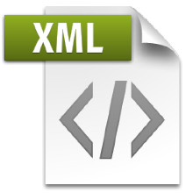
The Office Open XML Format
Created for Microsoft Office 2007+
Zip file containing <XML> and binaries – allows for embedded macros (generally created in VBA or Jscript)
Most of these are droppers for other malware
OFFICE MACROS
Primarily written in VBA
Access to Windows OS API
EMBEDDED FLASH OBJECTS
EMBEDDED JAVASCRIPT
METADATA
CONTENT

Slide 4
ANALYSIS Toolkit
OLETOOLS: olevba.py, oledump.py, olemeta.py, etc.
OfficeMalScanner.zip: OfficeMalScanner.exe, RTFScan.exe
JavaScript Analysis: js interpreter, JSDetox, jsunpack
REMnux: Reverse-Engineering Malware on Linux
A whole OS dedicated to ripping up malware
Contains many of the above tools
Easy to install as a VM (link)

Slide 5
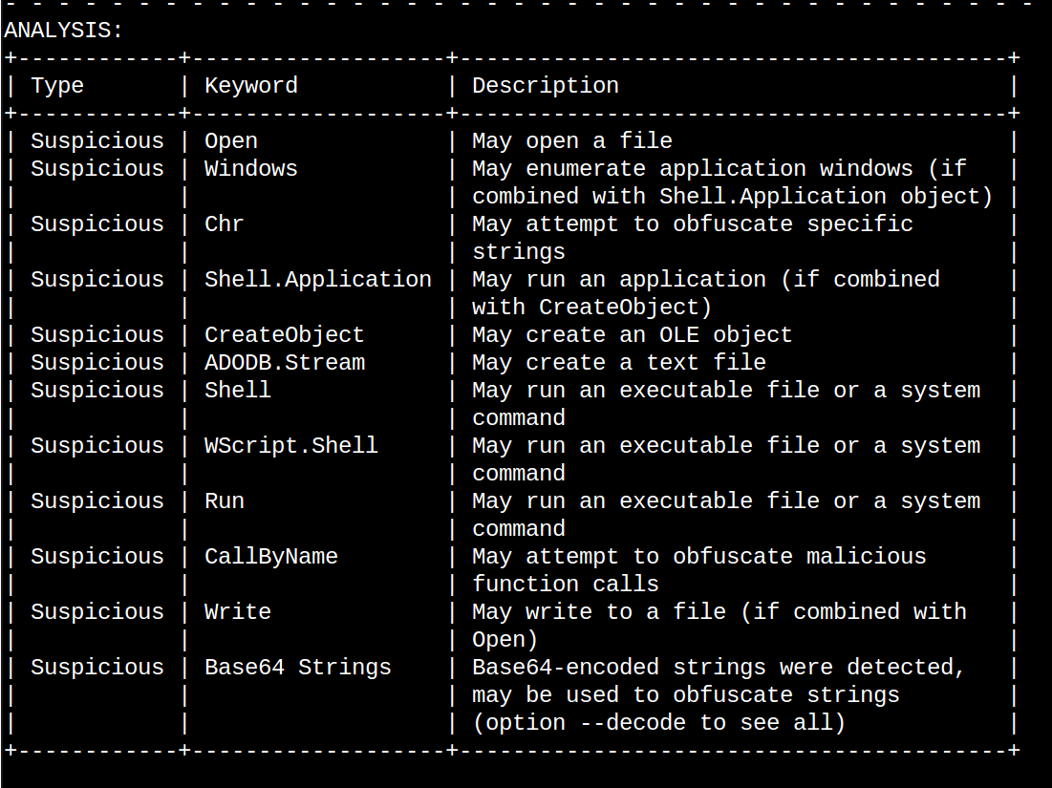
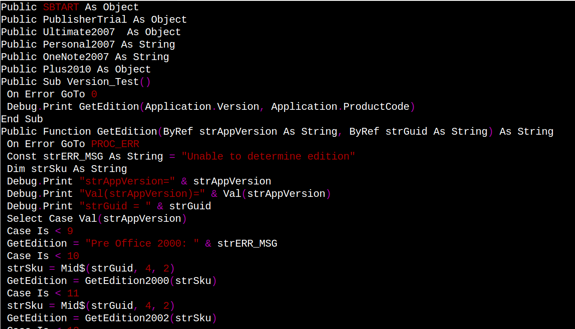
OLETools
A toolset for analyzing/extracting OLE objects from office documents
Personal favorite: OLEVBA.py

Slide 6
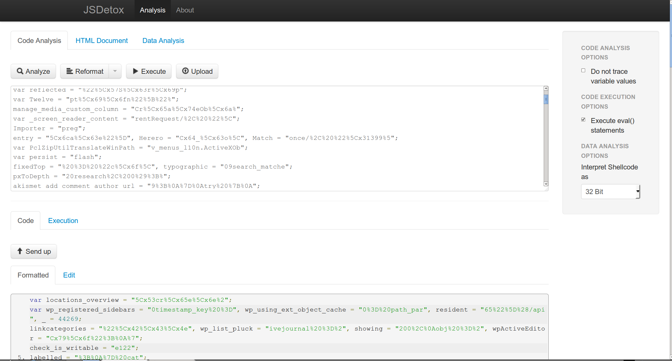
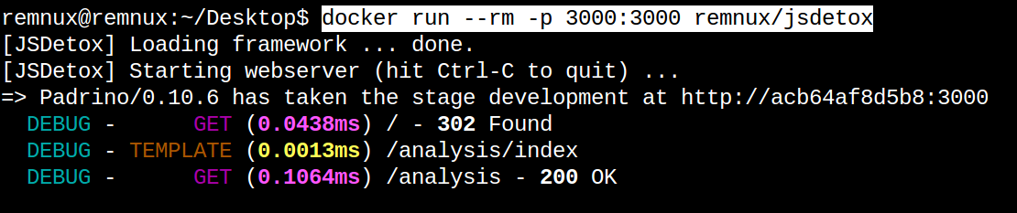
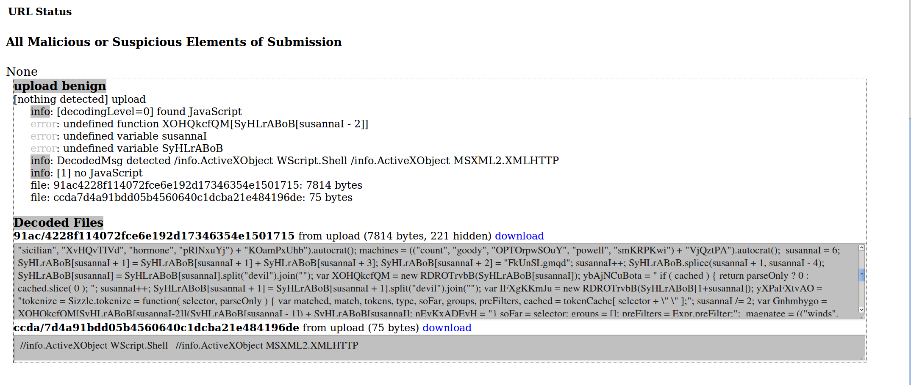
JS Analysis
js – A command line interpreter
Has some built-in objects and functions
Scripts usually take some TLC to get working
No native “document” object
print() replaces console.log()
js-beautify
Makes javascript files pretty
jsdetox
Webapp for JS analysis
Created by @sven_t of relentlesscoding.com
Comes with REMnux as a Docker image
jsunpack
Another JS analysis webapp
Been around a long time
Different types of tools
Web applications
Command line interpreters
Good old-fashioned text editors
Almost all of these are in REMnux

Slide 7
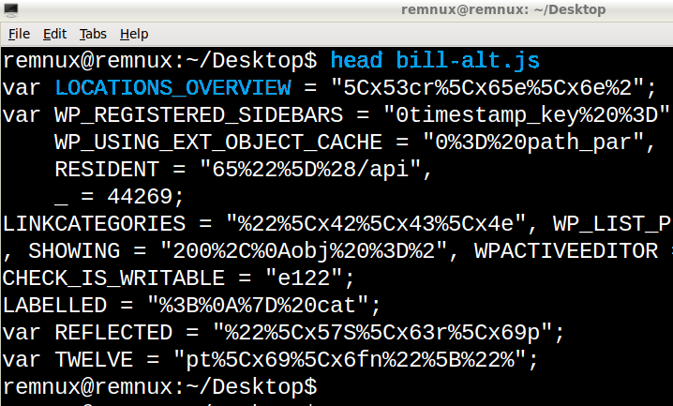
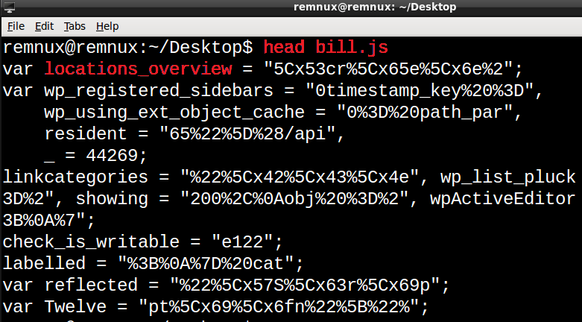
Anti-Virus Evasion Why Are Signatures Often Hard to Create?

Slide 8
Great References
REMnux – A great Linux distro for analyzing All The Things!
Lenny Zeltser – Maintains a great security blog and cheat sheets for everything. Created REMnux too!
Didier Stevens – Created a great walkthrough analysis on BlackEnergy. Regularly creates analysis and decoding scripts
SANS Infosec Handler’s Blog – Another great security blog
Malwr – Good malware repository. Based on Cuckoo
VirusTotal – Industry giant in sharing info about malware

Slide 9

https://github.com/infosec-intern/ Slides/blob/master/ A Different Kind of Docking/ A Different Kind Of Docking.pptx

Slide 10
THE END

